Slide 1

Introduction
The Super Store project encompasses a comprehensive dataset reflecting various aspects of a retail operation. The provided visuals and SQL queries reveal a multifaceted analysis of sales, profits, order priorities, and customer purchasing behaviors. With data across multiple countries and product categories, the project aims to dissect the store's performance, identify patterns, and determine areas for improvement

Slide 2

Objective
The primary objective of the Super Store project is to optimize the store's operations by analyzing key metrics such as total sales, profits, shipping costs, and discount strategies. The project also aims to enhance data integrity through the identification and removal of duplicate records and the standardization of data formats. By examining customer purchase frequencies and the profit-to-sales ratio, the store seeks to tailor its product offerings and marketing strategies more effectively to its customer base

Slide 3

Visualization

Slide 4

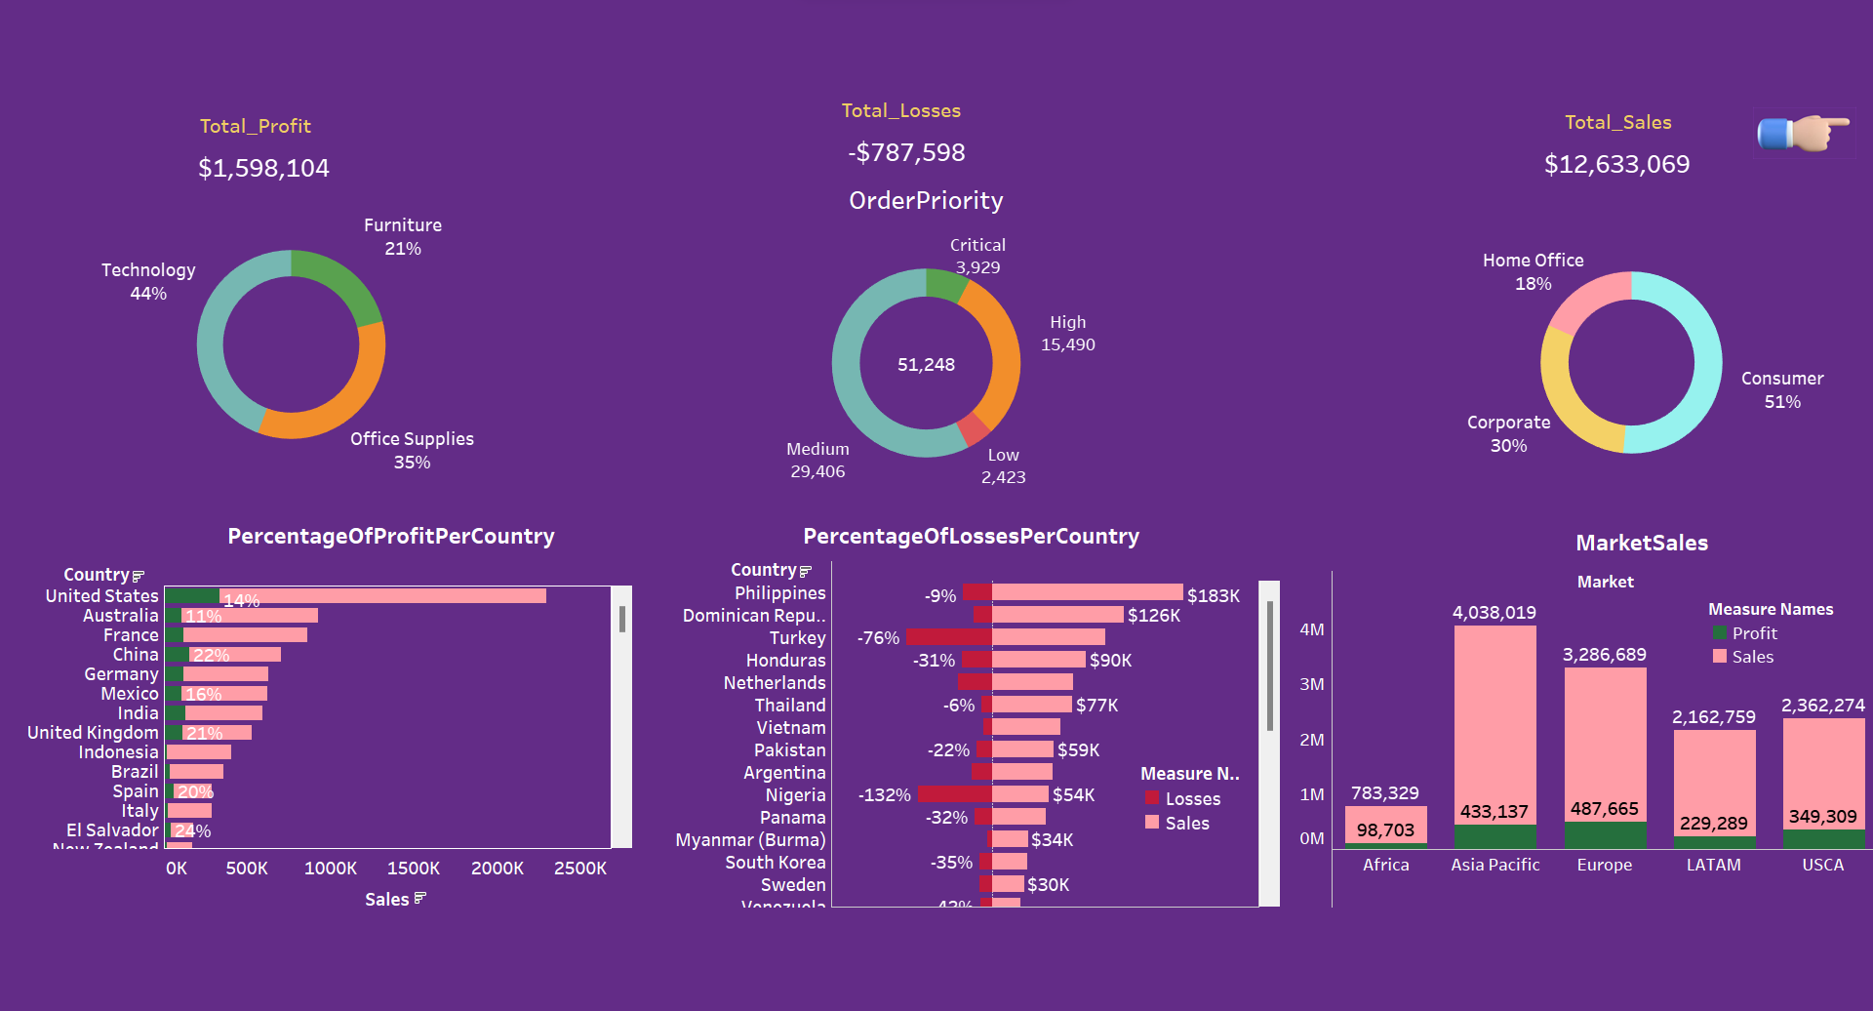
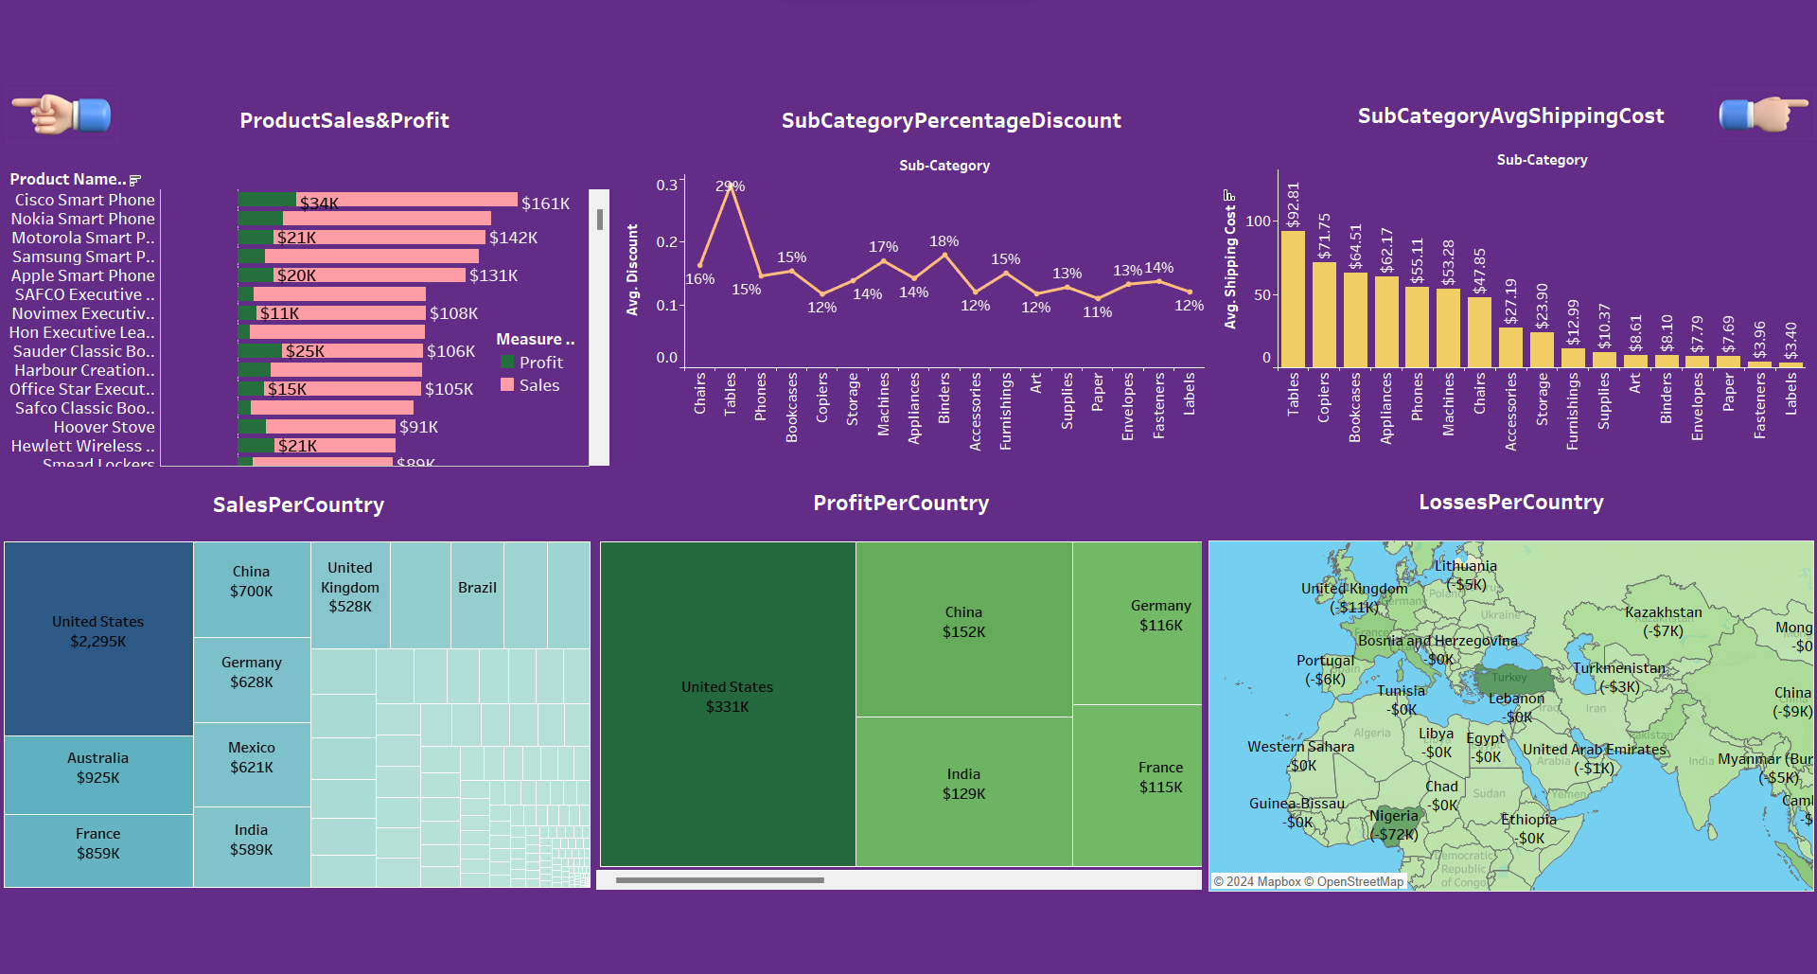
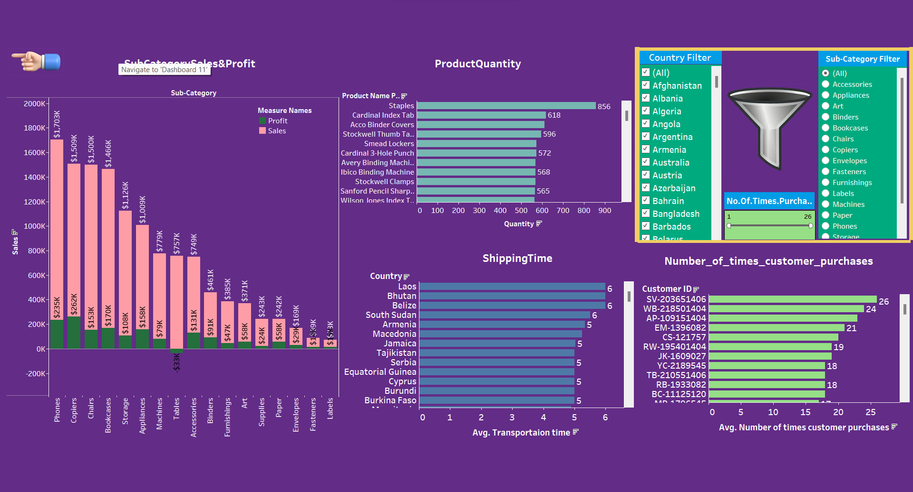
This dashboard provides a financial overview of a superstore project, with data on profits, losses, sales, and order priorities categorized by country and market:
Total Profit: The superstore made a total profit of $1,598,104.
Profit by Category: The largest share of profit comes from Technology (44%), followed by Office Supplies (35%), and Furniture (21%).
Total Losses: The store incurred total losses of -$787,598.
Order Priority: Most orders are of 'Medium' priority, with 'Critical' being the least.
Total Sales: The store had total sales of $12,633,069.
Sales by Segment: The Consumer segment constitutes the majority of sales (51%), followed by Corporate (30%), and Home Office (18%).
Profit and Sales by Country: The USA leads in profit percentage (14%) and sales. Countries like China (22%) and India (16%) also contribute significantly to sales. On the loss side, Venezuela leads with a -132% loss percentage.
Market Sales: The highest sales and profits are in the Asia Pacific market, followed by Europe, LATAM, and USCA.

Slide 5

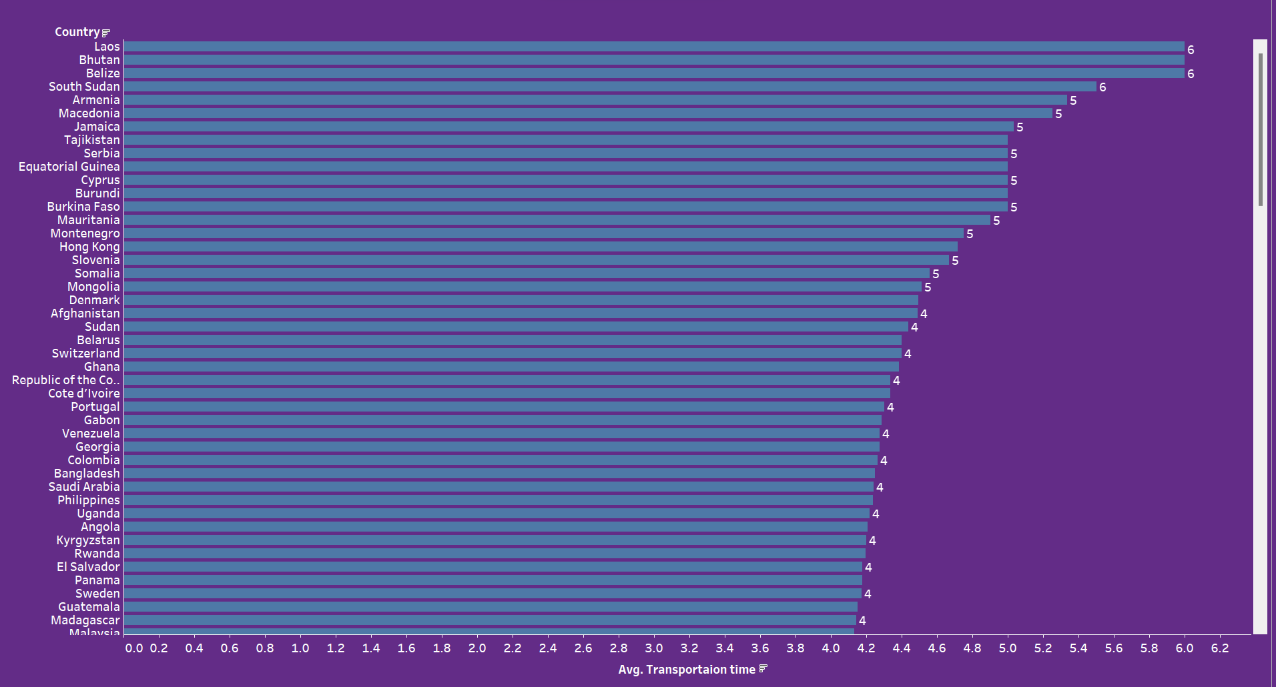
This dashboard focuses on sales, profits, discounts, shipping costs, and geographical distribution:
Product Sales & Profit: Cisco Smart Phones lead with the highest profit at $161K. The graph also shows sales figures alongside profits for other products.
Sales Per Country: The United States has the highest sales at $2.295K, followed by China, the United Kingdom, and others.
Profit Per Country: The United States again leads in profit at $331K, with China and India also being significant contributors.
Subcategory Percentage Discount: Chairs have the highest average discount at 29%, and labels the lowest at 12%.
Subcategory Average Shipping Cost: Copiers have the highest average shipping cost at $175.28, and labels the lowest at $3.90.
Losses Per Country: Notable losses are occurring in Turkey (-$7K) and India (-$5K), with several other countries showing smaller losses.

Slide 6

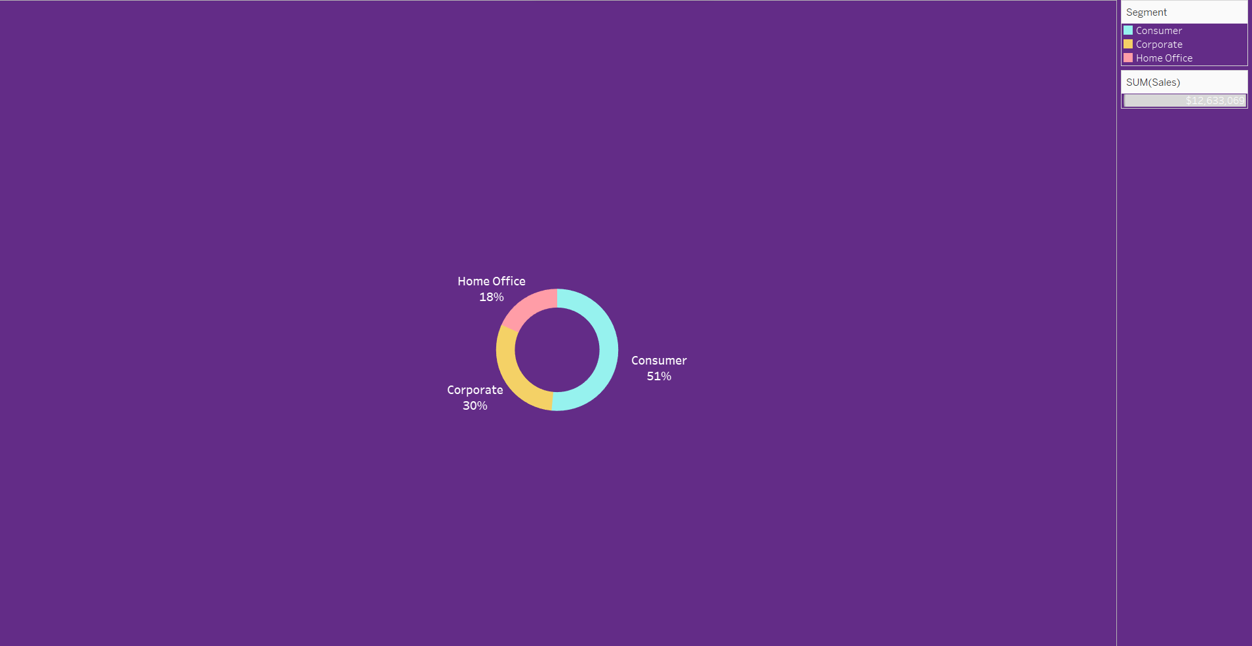
The dashboard provides data on sales and operations of a superstore:
Sub-Category Sales & Profit: Phones lead in sales, but not significantly in profit. Copiers have the highest profit relative to sales.
Product Quantity: Staples are the most sold items, with a quantity of 856.
Shipping Time: Laos, Bhutan, and Belize are countries with the highest average transportation time of 6 days.
Number of times customer purchases: A customer with ID SV-203651406 has the highest number of purchases at 26 times.
The data indicates strong sales in certain product categories like phones, with high profits in categories like copiers. Staples are the most frequently purchased item. Some countries experience relatively long shipping times, potentially impacting customer satisfaction. Additionally, a few customers show high loyalty or repeat purchase behavior

Slide 7

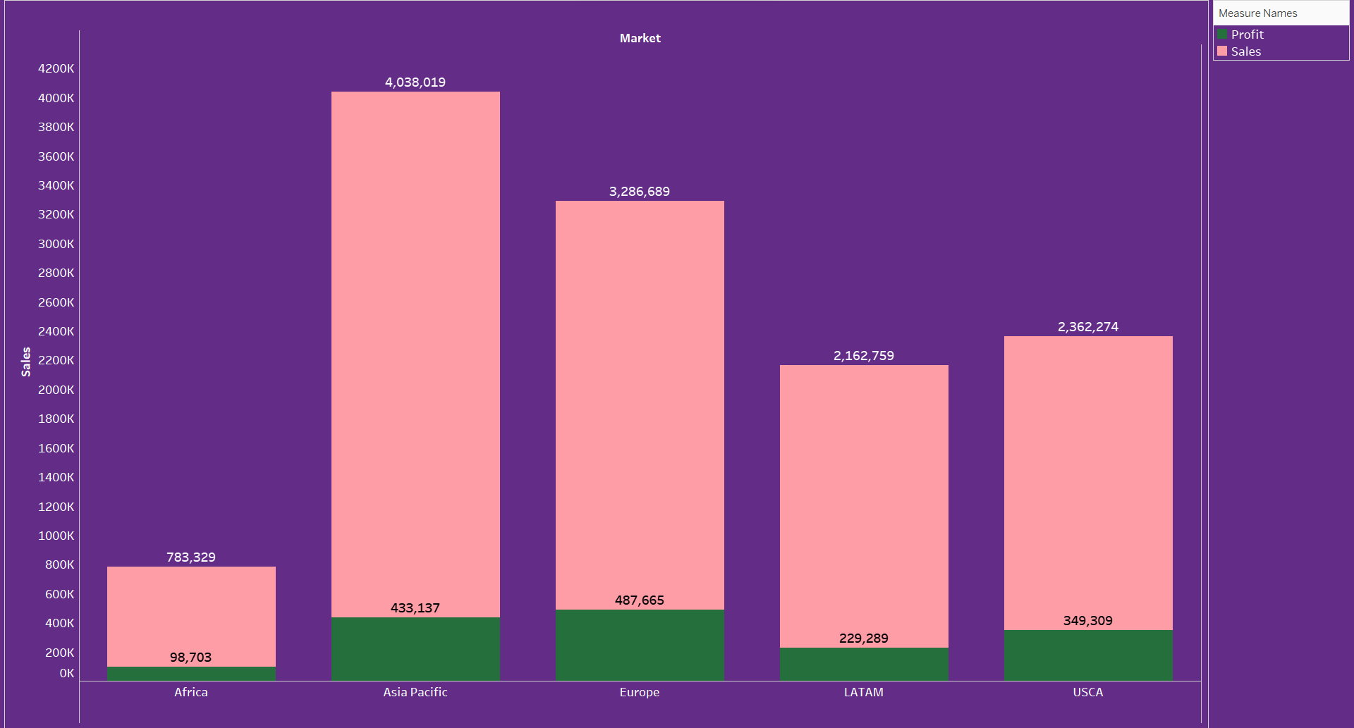
The chart displays average shipping time in days for various countries in a superstore project:
Laos, Bhutan, and Belize have the longest average shipping times at 6 days.
Several countries, including South Sudan, Armenia, and Macedonia, have an average shipping time of 5 days.
The majority of the countries listed have shipping times ranging between 4 and 5 days.
This suggests that shipping efficiency varies greatly by country, with some facing significantly longer delivery times. This could be due to various factors like distance, logistics infrastructure, or customs procedures

Slide 8

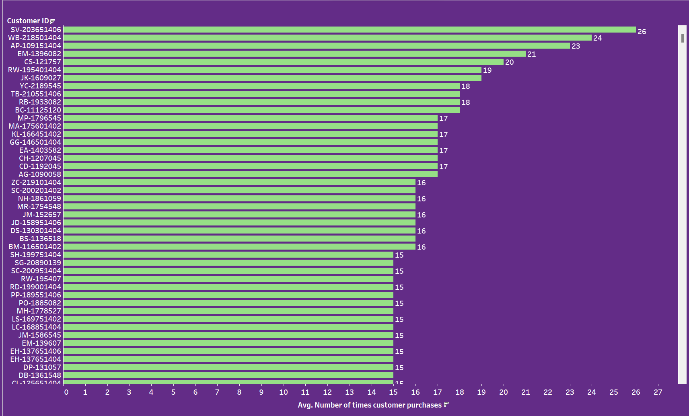
The chart shows sales distribution across different customer segments for a superstore:
Consumer Segment: The largest segment, accounting for 51% of total sales.
Corporate Segment: Makes up 30% of sales.
Home Office Segment: The smallest segment, at 18% of sales.
Total Sales: The combined sales from all segments amount to $12,633,069.
This indicates that the superstore's primary customer base is individual consumers, with significant but smaller contributions from corporate and home office segments

Slide 9

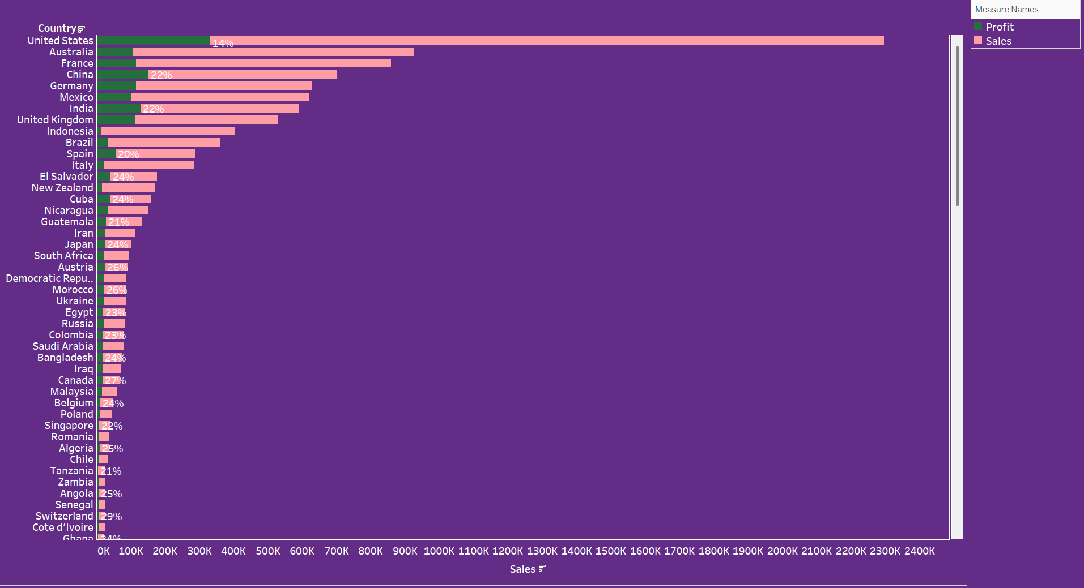
The chart shows a comparison of sales and profits across different markets for a superstore:
Asia Pacific: The highest sales at over 4 million and corresponding profit.
Europe: The second-highest sales and profit.
LATAM: Lower sales compared to Asia Pacific and Europe, with a moderate profit.
USCA: Similar to LATAM in sales, but with slightly higher profit.
Africa: The least sales and profit among the regions shown.
The Asia Pacific market is the most lucrative for the superstore, with the highest sales and profits, while Africa represents the smallest market

Slide 10

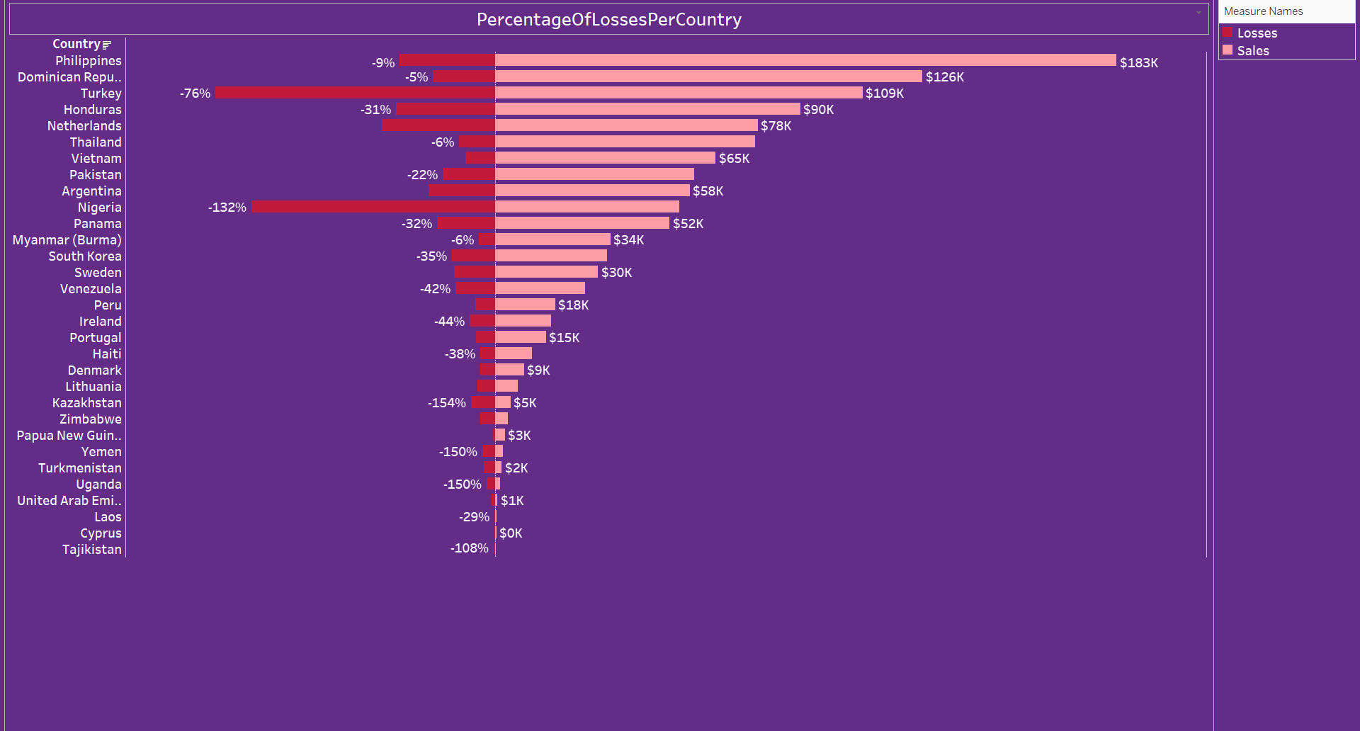
The chart presents data on the average number of times customers have made purchases at a superstore:
The customer with ID SV-203651406 has the highest number of purchases, averaging 26 times.
Several customers follow with purchase counts ranging from 15 to 24 times.
The majority of the listed customers have made purchases 15 times or more.
This indicates a core group of repeat customers who frequently shop at the superstore, suggesting a strong base of loyal customers

Slide 11

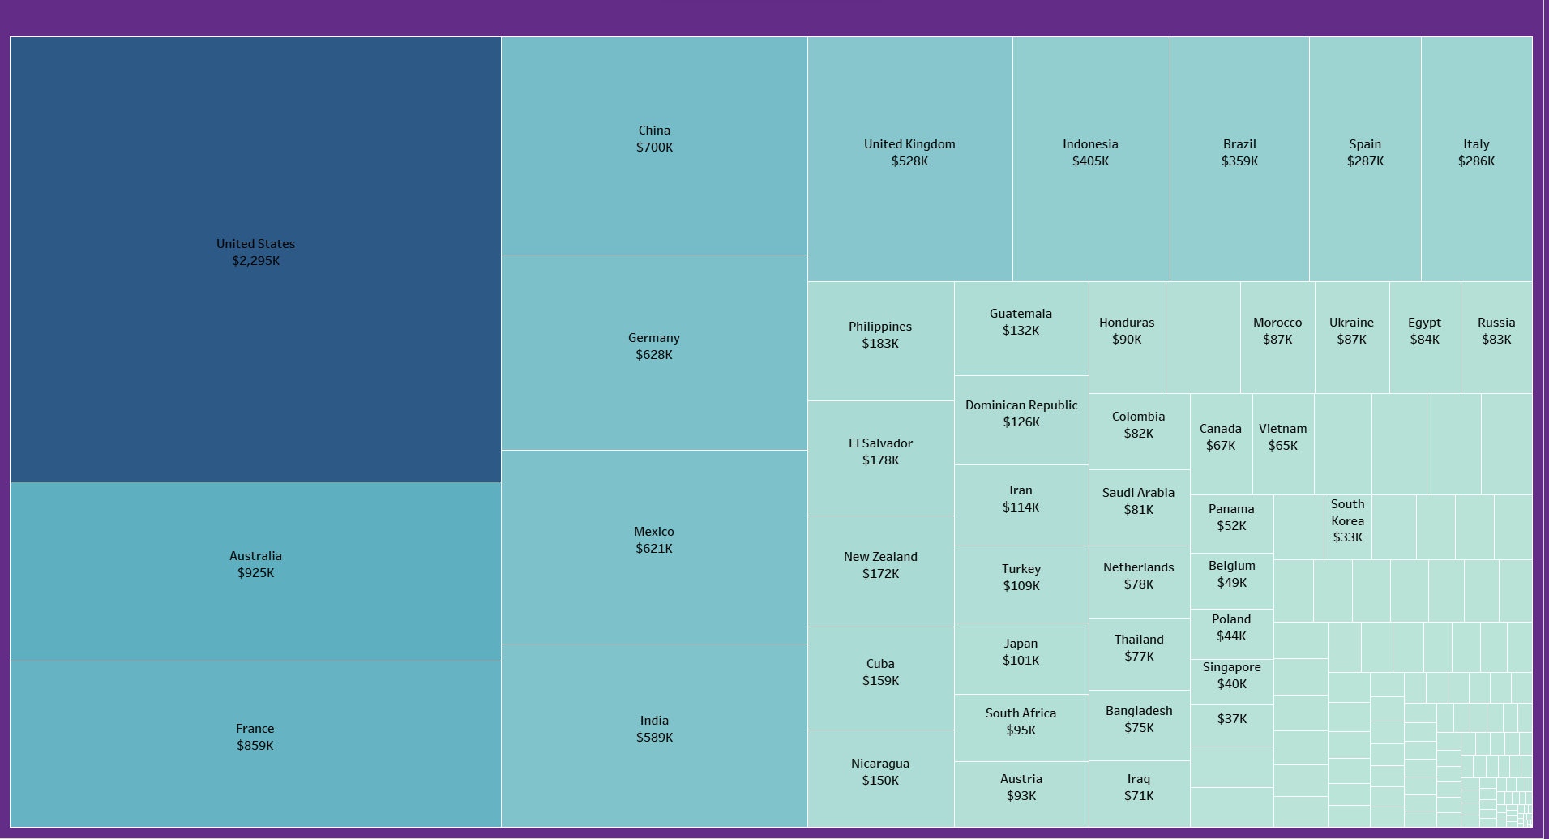
The chart appears to show sales and profit percentages by country for a superstore:
The United States stands out with the highest sales, and a profit percentage marked at 14%.
China and India are notable for having a significant amount of sales with profit percentages at 22% each.
Several countries have profit percentages ranging from 20% to 26%, with varying sales figures.
Switzerland shows a high profit percentage at 29%, although its sales volume is not as high as some other countries.
This visualization indicates that while the United States has the highest sales volume, other countries like China and India also contribute substantially to profits. Additionally, some countries with lower sales volumes still maintain high profit percentages, which could indicate effective pricing strategies or lower costs in those markets

Slide 12

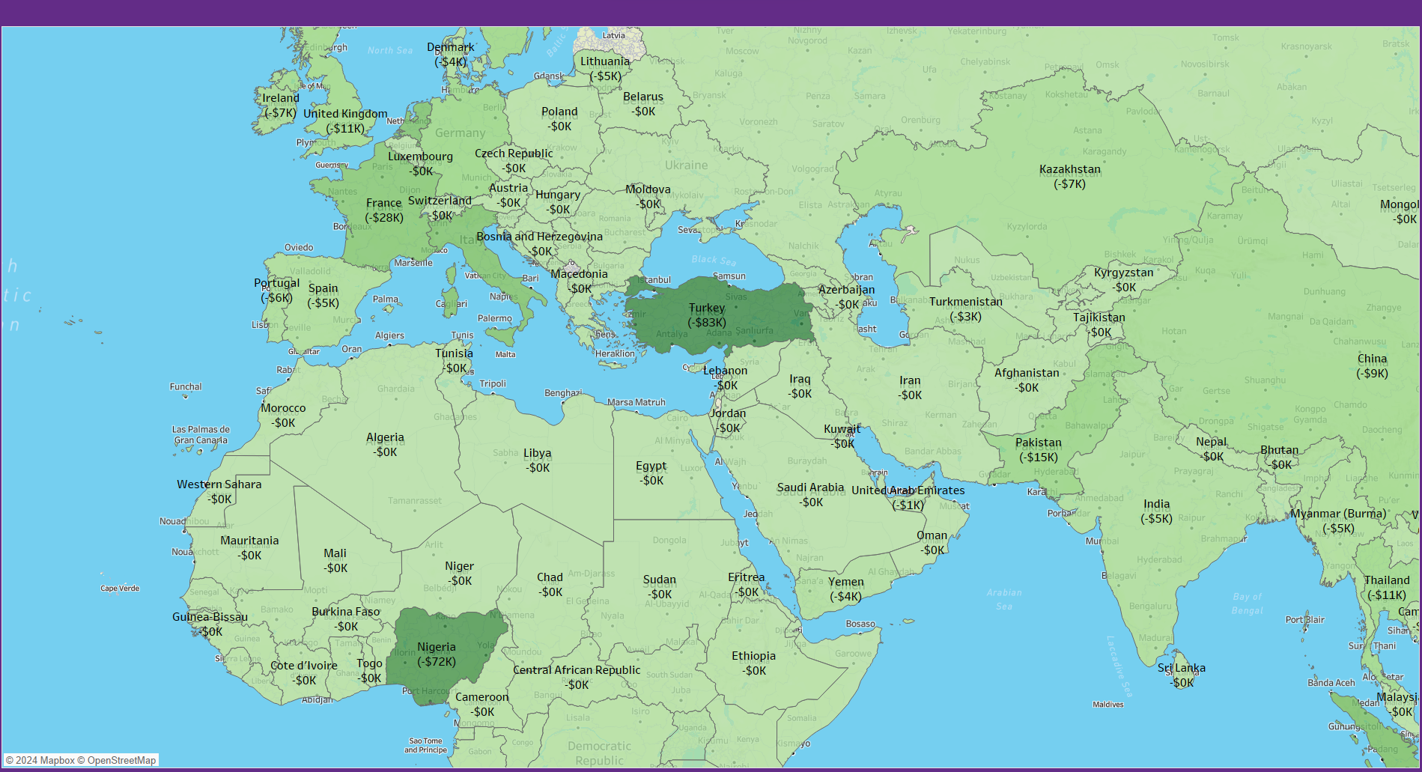
The chart displays the percentage of losses and the actual monetary losses by country for a superstore:
The Philippines has the highest monetary loss at $183K with a -9% loss percentage.
Turkey has a significant monetary loss of $109K with a large -76% loss percentage.
Notably high percentages of losses are seen in countries like Venezuela (-42%), Kazakhstan (-154%), Yemen (-150%), and Turkmenistan (-150%).
The losses in some countries exceed the sales, indicated by percentages over 100%, which is quite concerning and could be indicative of severe issues in operations, pricing, or market conditions in those regions.
This data suggests that while the superstore may be profitable overall, there are specific countries where the operation is incurring substantial losses, which may require strategic review and action

Slide 13

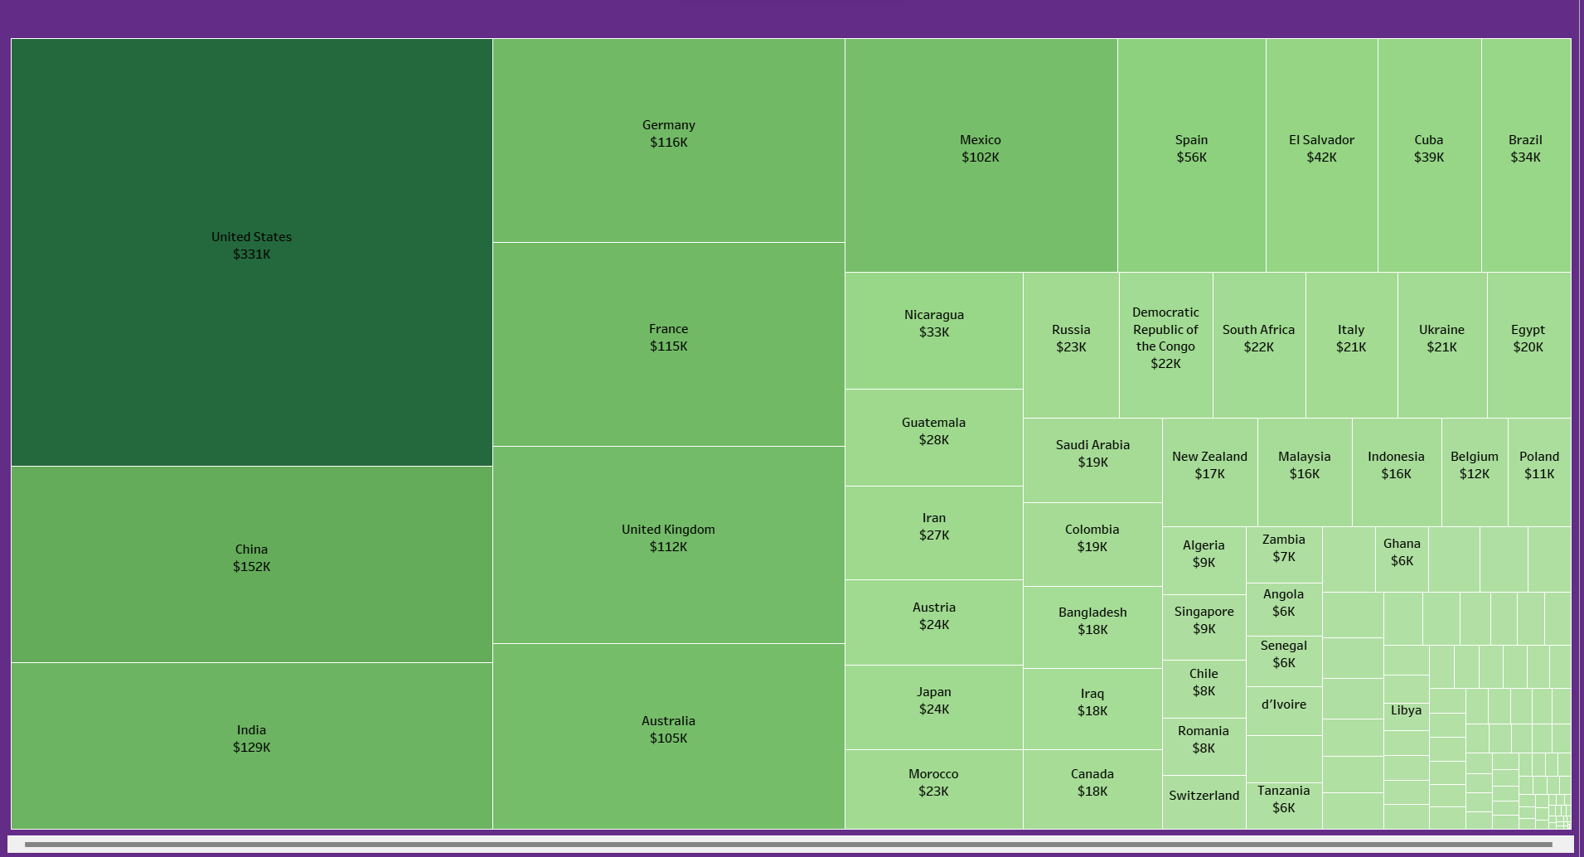
The chart is a treemap visualizing sales data for a superstore, with each box representing a country and its corresponding sales value:
The United States dominates the treemap with the highest sales at $2.295K (thousands).
Other countries with significant sales include China at $700K, Australia at $925K, and India at $589K.
Smaller boxes represent countries with lower sales, such as South Korea at $33K and Singapore at $40K.
European countries like the United Kingdom, Germany, and France also have notable sales figures ranging from $528K to $859K.
The size of each box is proportional to the sales volume from that country, with the United States being the largest market for the superstore

Slide 14

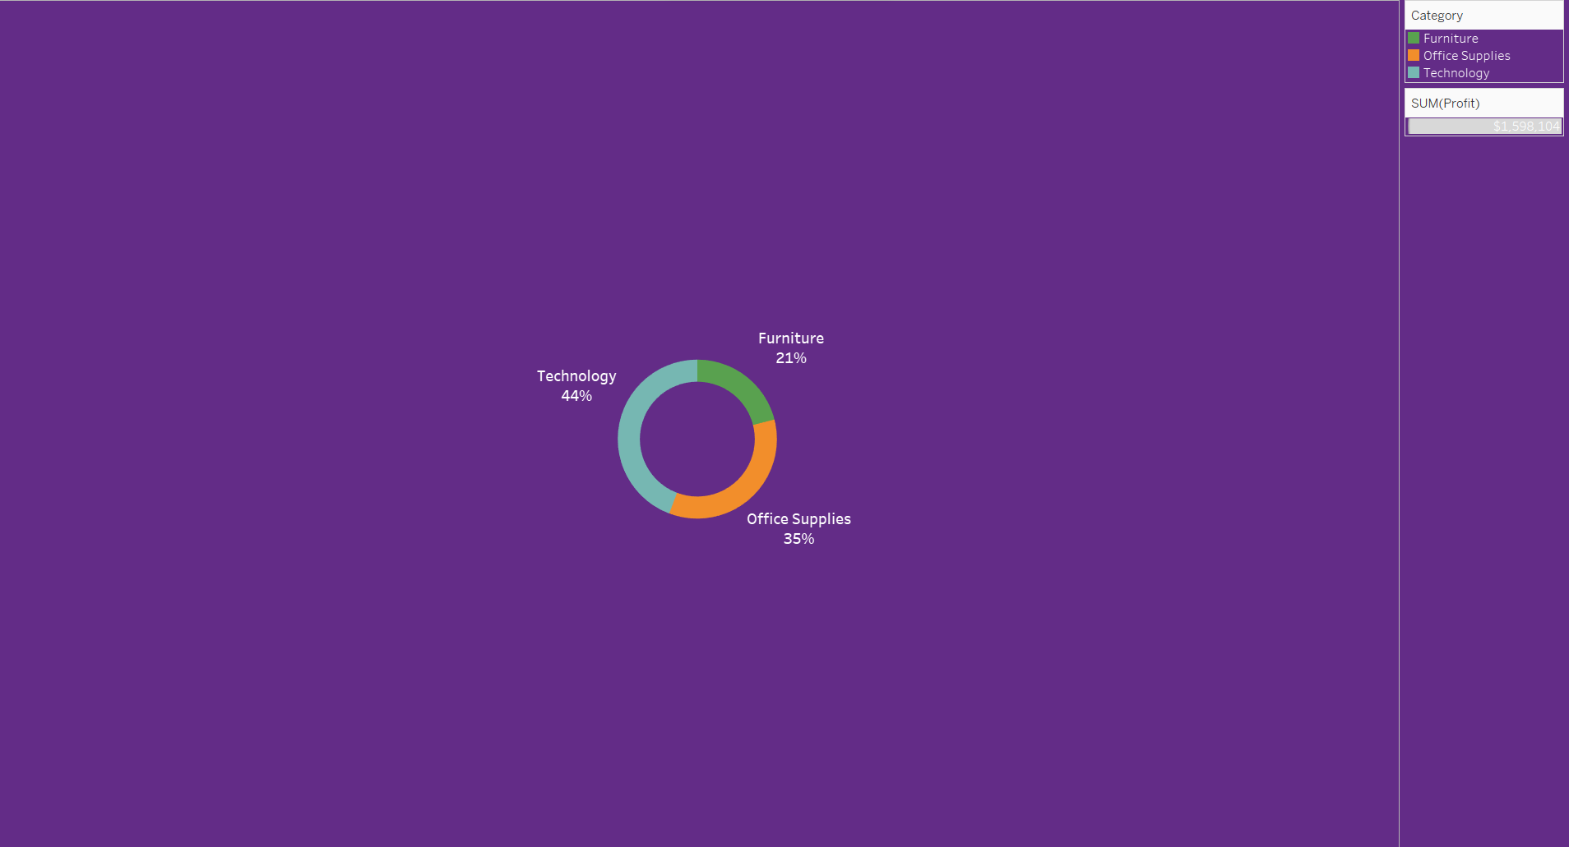
The map you've provided shows losses by country for a superstore:
Turkey has the largest loss noted on the map at -$83K.
Other countries with significant losses include the United Kingdom (-$111K), Ireland (-$7K), and France (-$28K).
There are also losses across various countries in Africa, the Middle East, and Asia, with amounts ranging from -$1K to -$55K.
Notably, there are losses in India (-$55K) and China (-$9K), despite these countries having significant sales in other data provided.
The visual suggests that while some countries are profitable, there are others where the superstore is facing financial losses

Slide 15
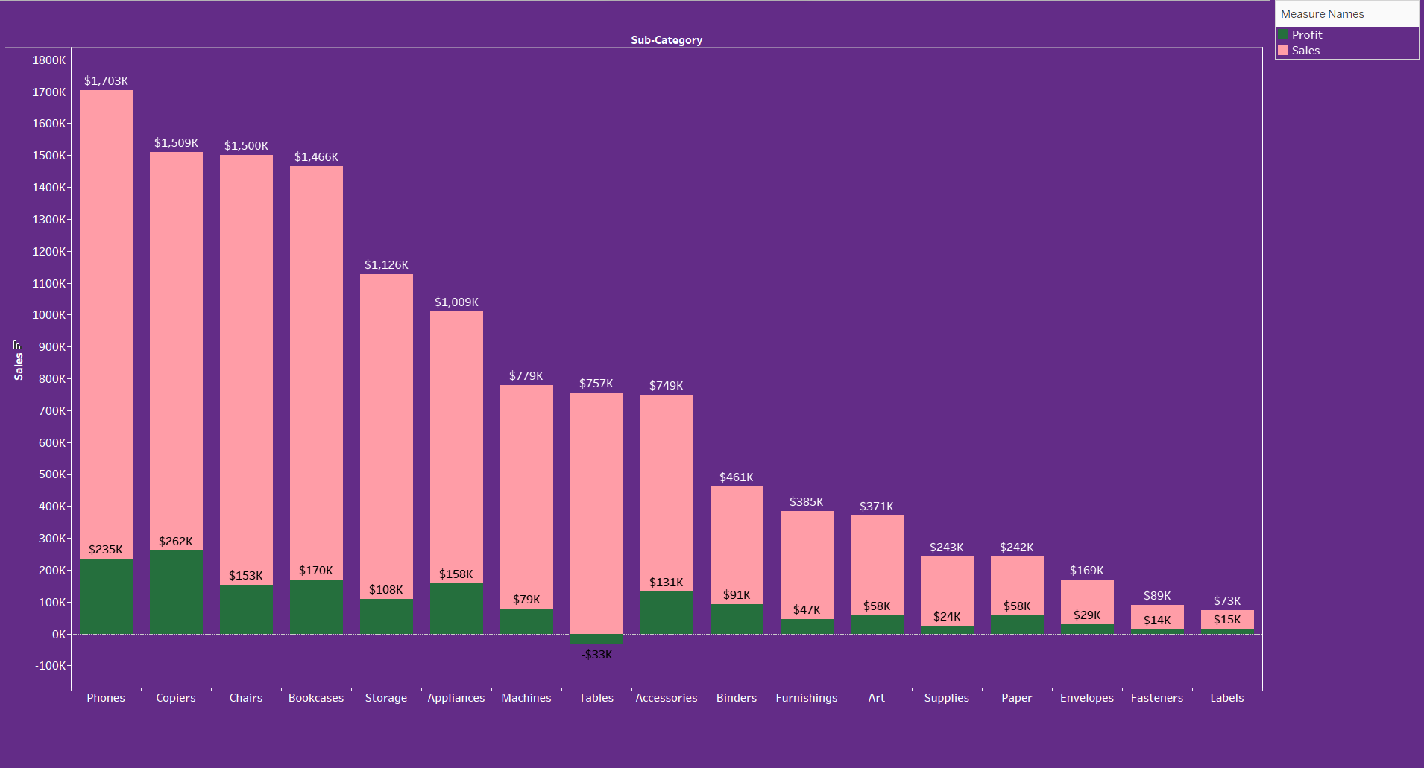
The treemap visualization indicates profit distribution by country for a superstore:
The United States has the highest profit at $331K.
Other countries with substantial profits include China at $152K, Germany at $116K, and France at $115K.
The treemap also includes a variety of other countries with smaller profit amounts, suggesting a widespread international operation.
The sizes of the boxes correspond to the amount of profit, indicating that the superstore's profits are heavily concentrated in the United States

Slide 16

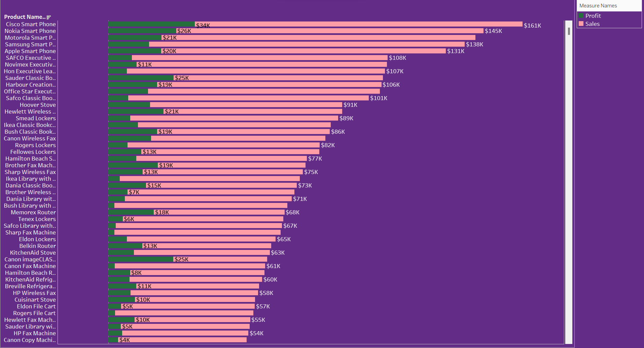
The donut chart illustrates the distribution of profit across three product categories for a superstore:
Technology: Represents the largest share of profit at 44%.
Office Supplies: The second-largest category, contributing 35% to the profit.
Furniture: The smallest share at 21%.
The total profit for the superstore, as indicated by the chart, sums up to $1,598,104. This suggests a strong performance in the technology sector relative to the other categories

Slide 17

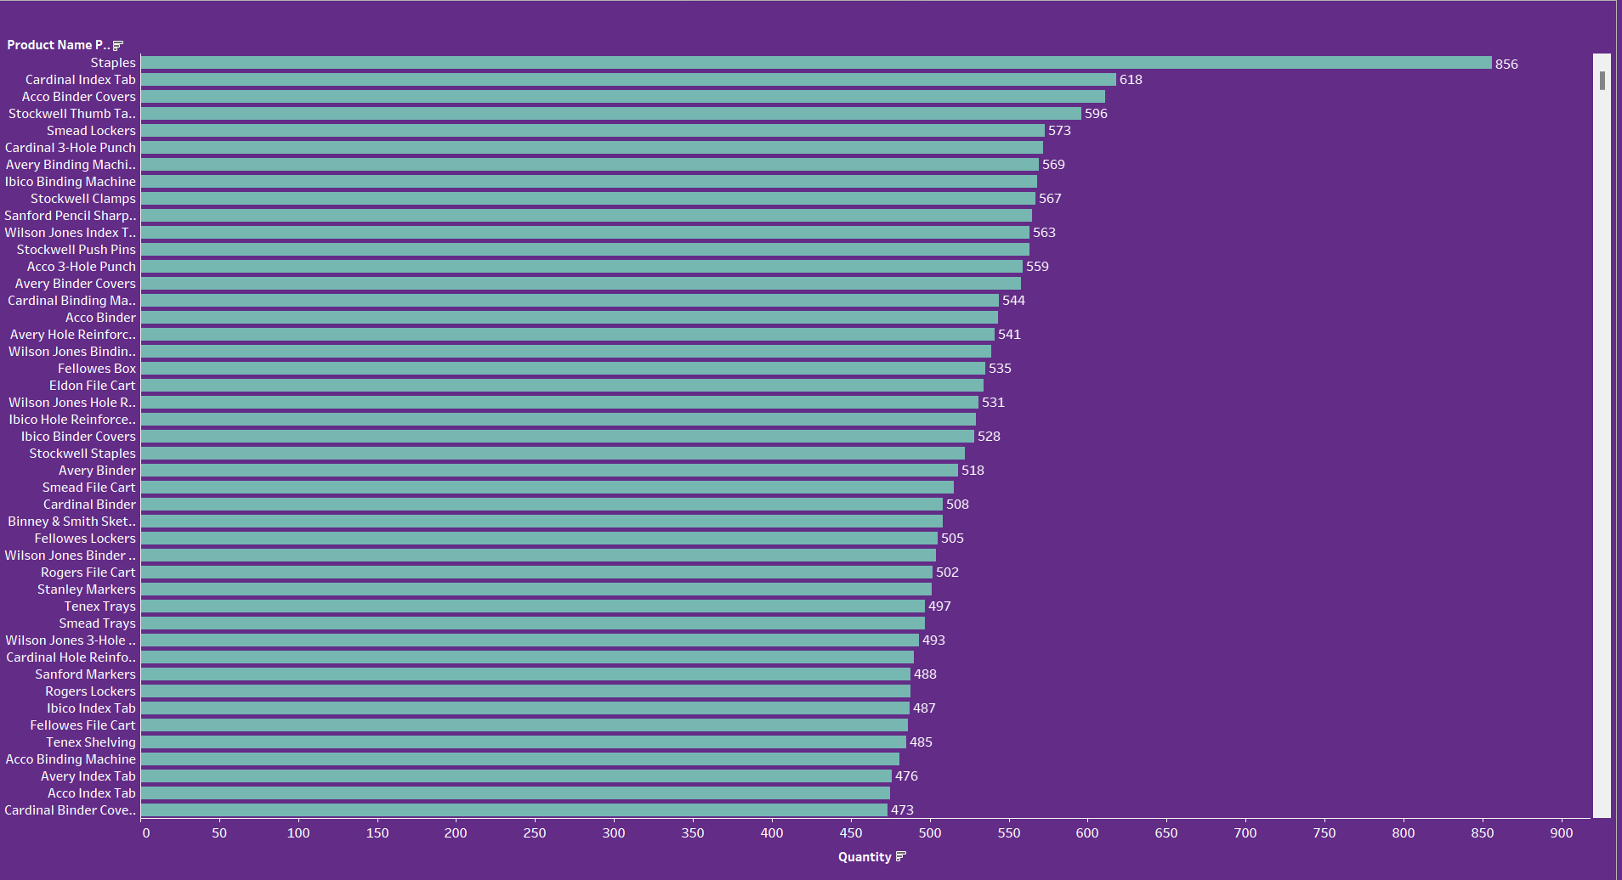
The bar chart depicts sales and profits across various sub-categories for a superstore:
Phones generate the highest sales at approximately $1.703M, with substantial profit.
Copiers, while having slightly lower sales, show a very high profit relative to sales.
Chairs and Bookcases also have high sales figures, though their profits are lower compared to Phones and Copiers.
The least profitable sub-categories are Supplies, Labels, and Fasteners, with relatively small sales figures and profits.
This indicates that while Phones are the best-selling items, Copiers offer a high profit margin. It also suggests that the superstore may need to evaluate the profitability of the lower-performing sub-categories

Slide 18

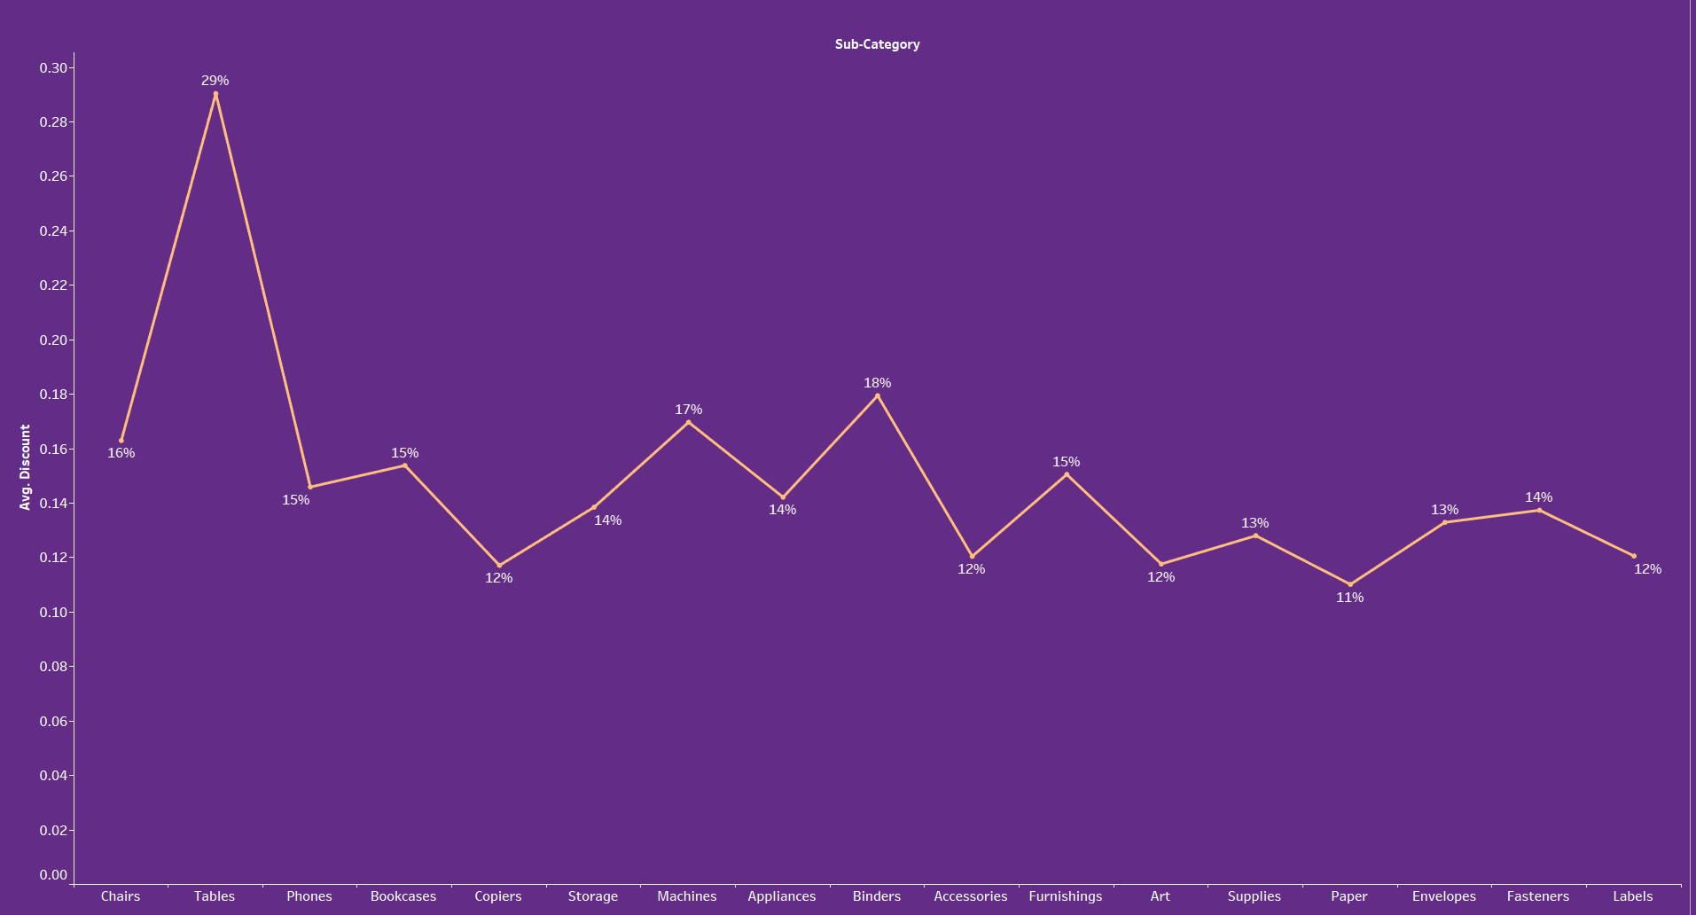
The bar chart provides sales and profit data for individual products:
Cisco Smart Phones show the highest profit at $161K with sales of $34K.
Nokia Smart Phones also demonstrate high profitability at $145K.
The chart further details a variety of products, showing a clear distinction between sales and profit for each.
This information indicates specific products, particularly smart phones, as significant profit drivers, despite their sales not being the highest. This could suggest high margins or a successful sales strategy for these items

Slide 19

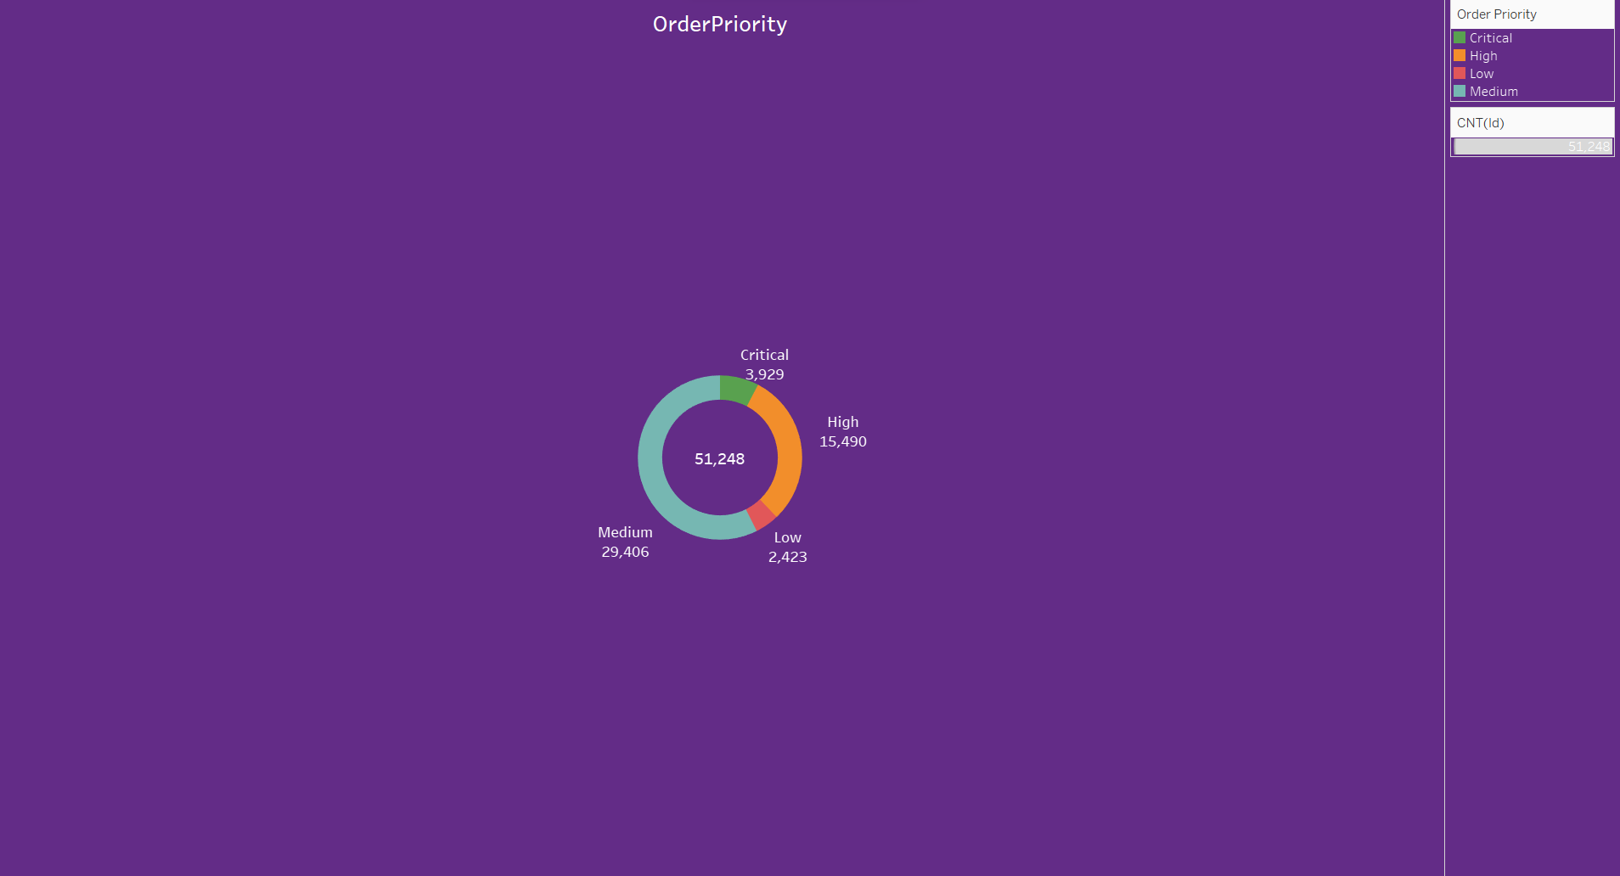
The bar chart displays the quantity sold for various products at a superstore:
Staples have the highest quantity sold at 856 units.
Cardinal Index Tabs and Acco Binder Covers are also among the top, with 618 and 596 units sold, respectively.
Other products, such as Stockwell Thumb Tacks and Smead Lockers, show moderately high sales quantities, ranging from 573 to 567 units.
The chart continues to list various other office-related products with their respective quantities sold, indicating a diverse range of items being purchased.
The data suggests a high demand for basic office supplies like staples and binder accessories

Slide 20

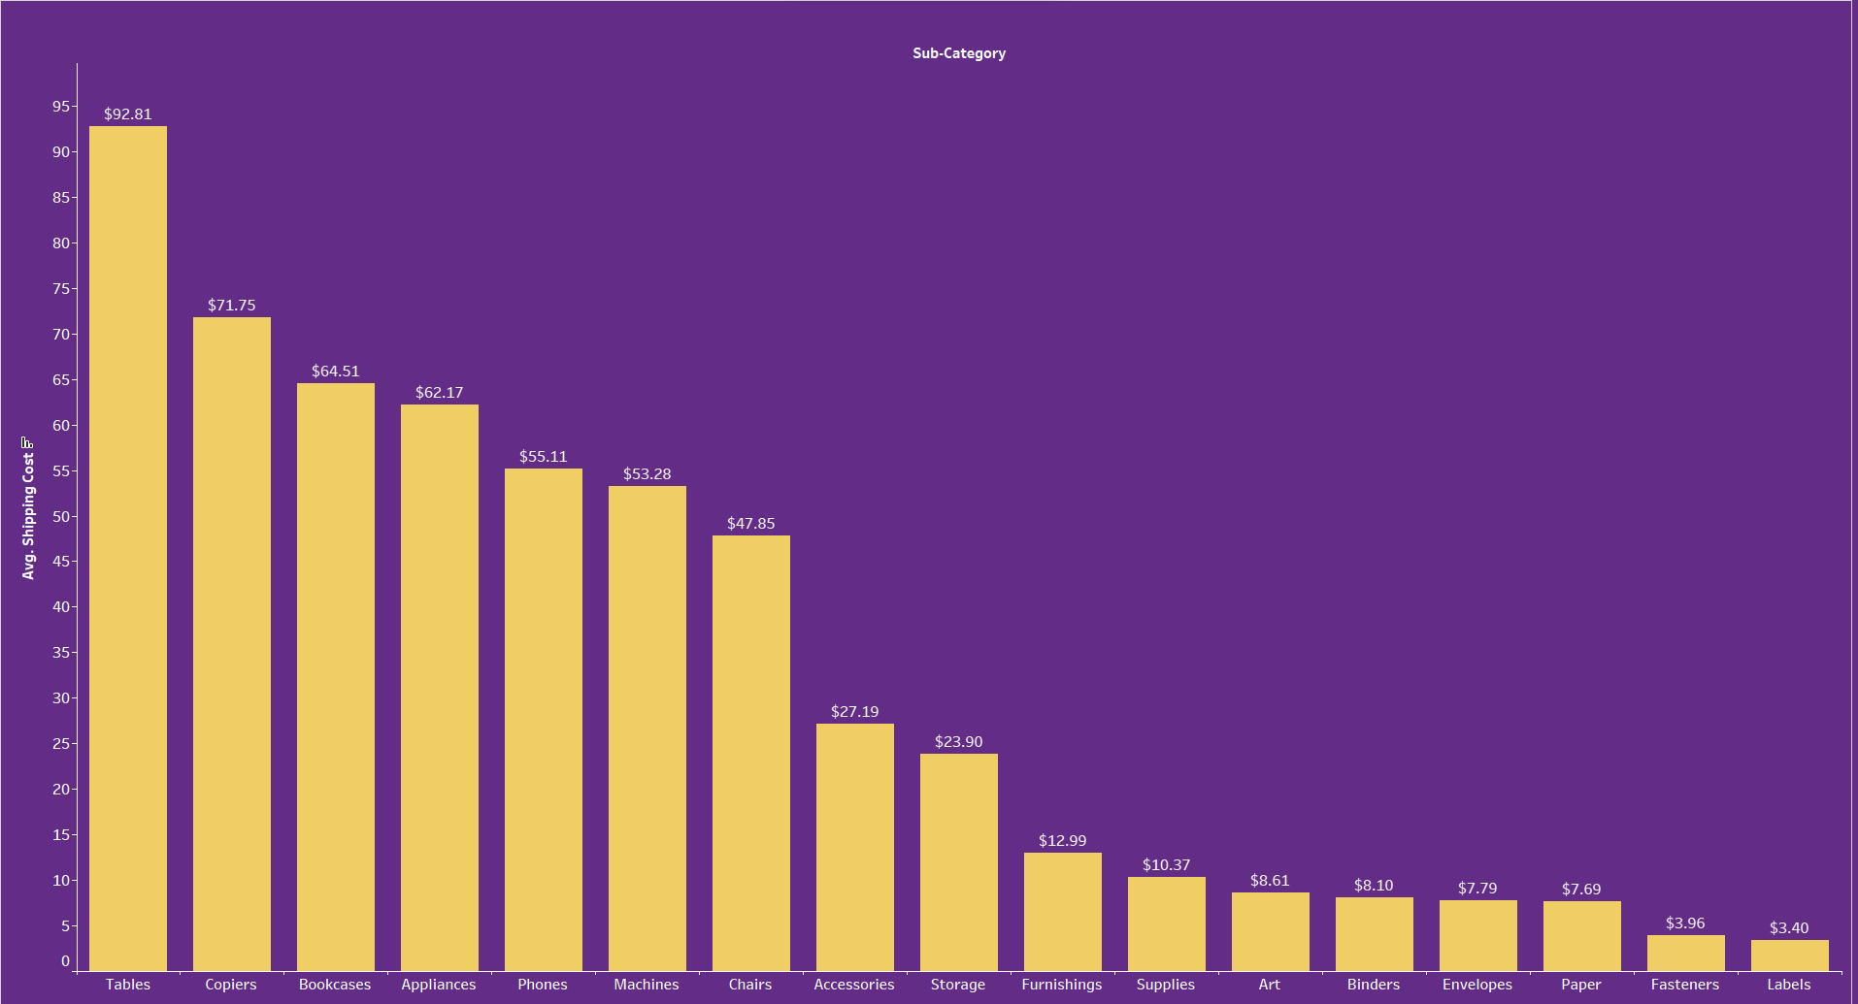
The line chart depicts the average discount given across various sub-categories in a superstore:
Chairs receive the highest average discount at 29%.
Other categories with notable discounts include Appliances (18%) and Phones (15%).
The categories with the lowest discounts are Labels (12%) and Fasteners (14%).
There's a significant variation in discount levels across categories, suggesting strategic price reductions in certain areas, possibly to drive sales or clear inventory

Slide 21

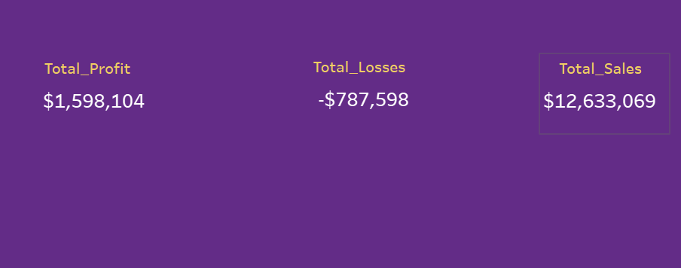
The donut chart displays the distribution of order priorities for a superstore:
The largest segment is 'Medium' priority orders, totaling 29,406.
'High' priority orders are the next largest at 15,490.
'Low' priority orders are the smallest group, with 2,423.
'Critical' priority orders are slightly more than 'Low', at 3,929.
The chart indicates that most orders fall into the 'Medium' priority category, suggesting that there are relatively few orders that are considered either 'Low' or 'Critical'

Slide 22

The bar chart illustrates the average shipping cost for various sub-categories of products:
Tables have the highest average shipping cost at $92.81.
Copiers also have a high shipping cost, averaging $71.75.
On the lower end, Labels have the smallest average shipping cost at $3.40, with Fasteners and Paper also on the lower side, costing under $8.
The data shows a significant range in shipping costs across sub-categories, which could be influenced by the size, weight, and handling requirements of the products
.

Slide 23
The image displays key financial figures for a superstore:
Total Profit: The superstore has earned a total profit of $1,598,104.
Total Losses: It has incurred total losses of $787,598.
Total Sales: The total sales amount to $12,633,069.
These numbers indicate that while the store has substantial sales, there is a significant amount of losses. However, the total profit suggests that the store's operations are still profitable overall
.

Slide 24
Code

Slide 25

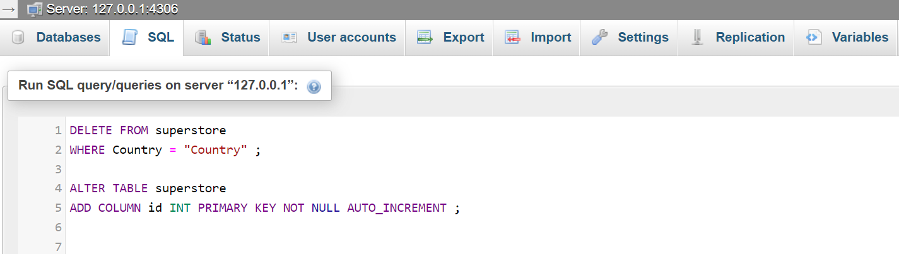
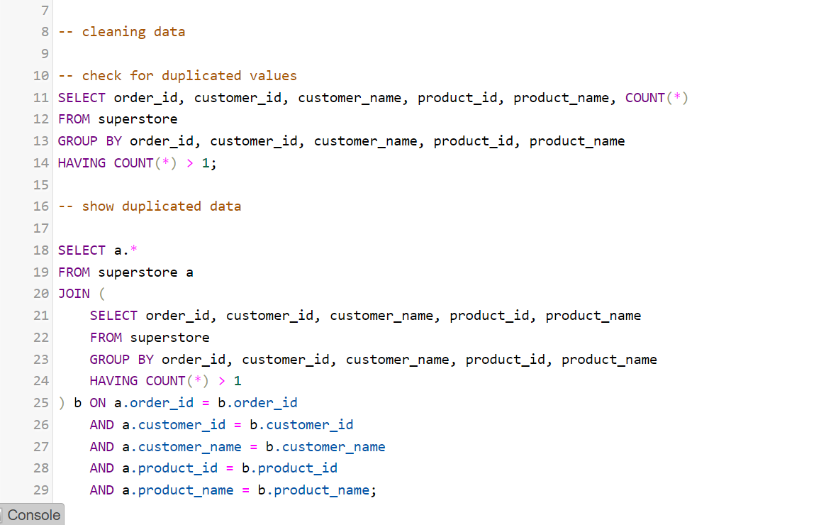
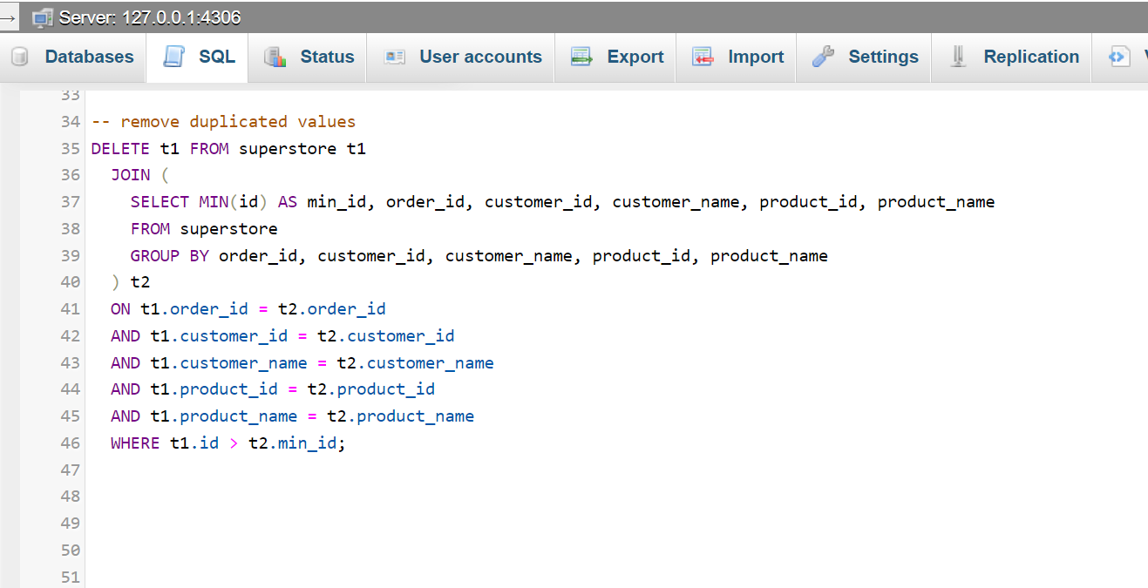
The provided SQL code performs two operations on a database table named superstore:
Deletes all rows where the Country column has the value "Country". This might be cleaning out placeholder or erroneous data.
Adds a new column named id to the superstore table, designates it as the PRIMARY KEY, and ensures it cannot be null. The AUTO_INCREMENT attribute means each new record will automatically be assigned a unique ID, increasing sequentially.
Essentially, this code is meant to sanitize the data by removing invalid entries and structuring the table to have a unique identifier for each row

Slide 26

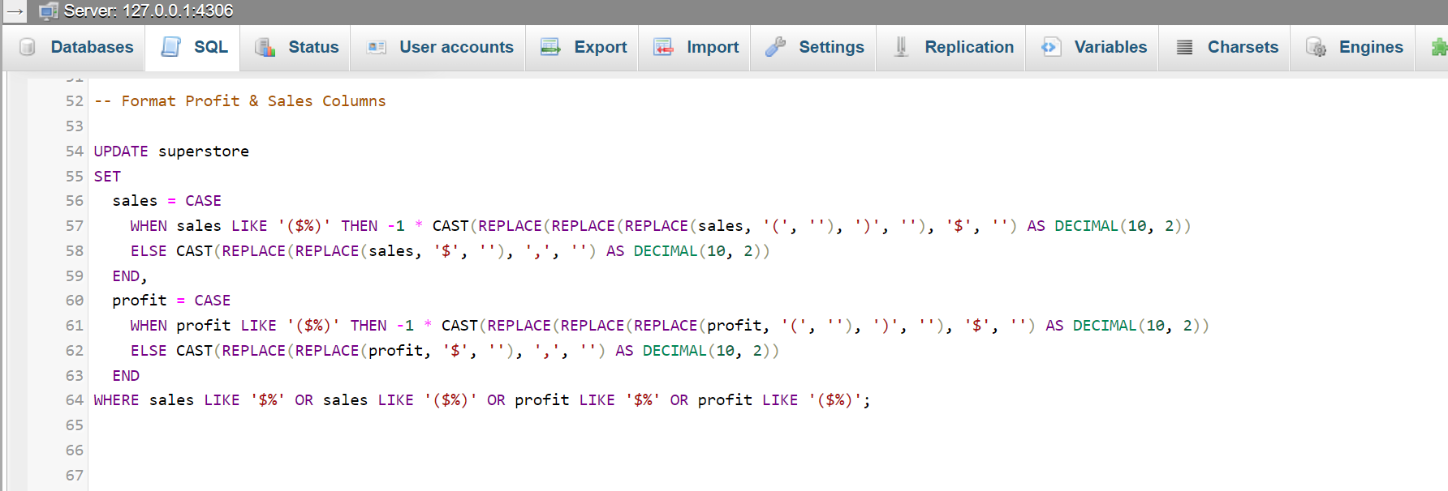
The SQL queries provided are focused on identifying and displaying duplicated records in the superstore database table:
Check for duplicated values: This query selects records that have duplicate combinations of order_id, customer_id, customer_name, product_id, and product_name. It groups the data by these fields and filters for groups with a count higher than one, indicating duplicates.
Show duplicated data: This query retrieves all columns for the duplicate records identified in the first query. It joins the superstore table with a subquery that finds duplicated records, matching on the fields used to determine duplication. This will show the complete data for all duplicate entries based on the mentioned fields.
These queries are part of data cleaning to ensure the integrity of the data by identifying and potentially removing or correcting duplicated entries in the dataset

Slide 27

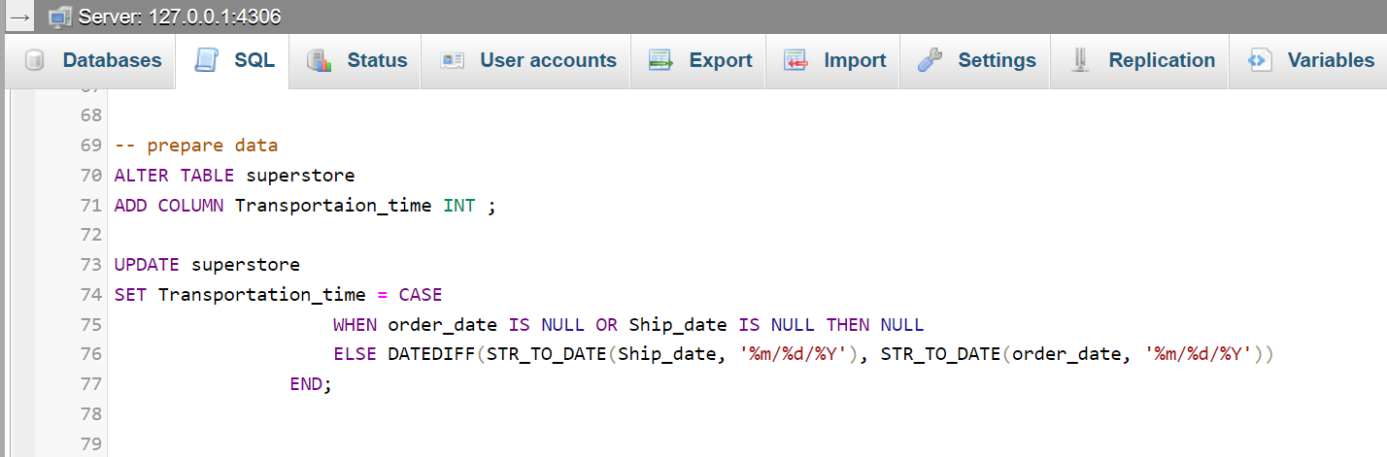
The SQL command you've provided is designed to delete duplicate records in the superstore table:
It identifies duplicates based on the combination of order_id, customer_id, customer_name, product_id, and product_name.
For each set of duplicates, it keeps only the record with the smallest id (assumed to be the first or original entry) and deletes the rest.
The DELETE command removes any t1 records that have a matching set in t2 (the subquery that identifies duplicates) but have an id larger than the minimum id found for those duplicates.
This approach ensures that only one record per unique combination of the specified fields remains in the table, effectively de-duplicating the data

Slide 28

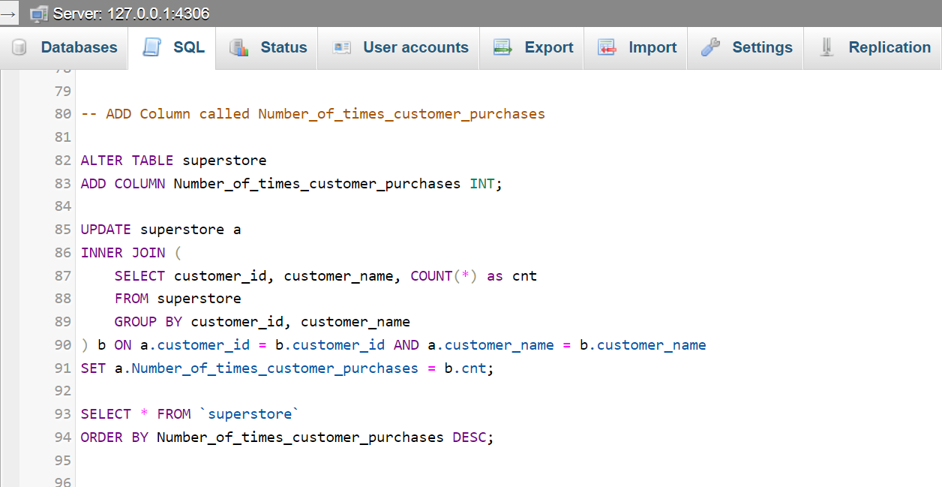
The SQL statement provided is meant to update the formatting of the sales and profit columns in the superstore table:
It looks for values in the sales and profit columns that are formatted as currency, which can be recognized by the presence of $ and possibly parentheses (indicating negative amounts).
For sales and profit values enclosed in parentheses, which denote negative figures, the statement removes the parentheses and the dollar sign, multiplies the number by -1 to make it a negative value, and casts it as a DECIMAL with two decimal places.
For positive sales and profit values, it removes the dollar sign and any commas, then casts the result as a DECIMAL type with two decimal places.
The UPDATE is applied only to rows where sales or profit are formatted as currency (starting with a dollar sign or enclosed in parentheses and a dollar sign).
This command standardizes the sales and profit data into a consistent numeric format, which is crucial for accurate calculations and reporting

Slide 29
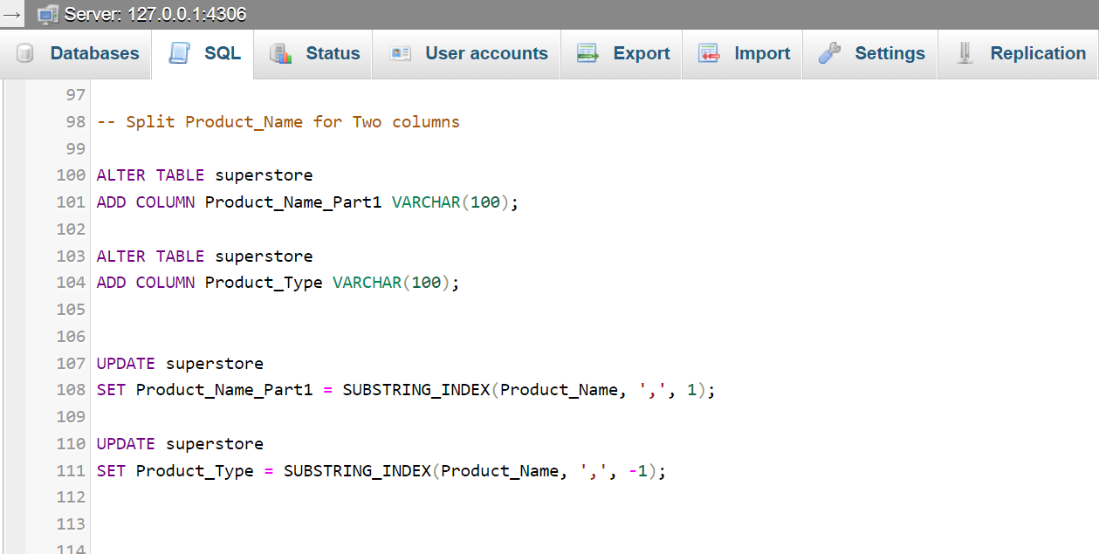
The SQL code provided includes two parts for preparing the superstore table data:
Add a new column:
The ALTER TABLE statement is adding a new column called Transportation_time of type INT to the superstore table. This column is intended to store an integer value representing the transportation time.
Update the new column:
The UPDATE statement sets the value of the Transportation_time column. It uses a CASE expression to determine the value:
If either order_date or Ship_date is NULL (meaning there's no date provided), the Transportation_time is set to NULL.
Otherwise, it calculates the difference in days between Ship_date and order_date. The DATEDIFF function computes this difference, and the STR_TO_DATE function converts the string date format into a date object that DATEDIFF can use for its calculation.
Please note that there seems to be a typo in the code: the column is added as Transportaion_time, but the update statement references Transportation_time. The column name should be consistent in both statements.

Slide 30
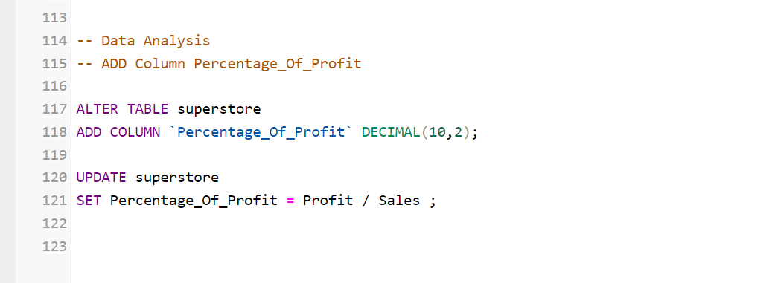
The SQL code provided executes the following actions on the superstore table:
Add a new column:
The ALTER TABLE statement adds a new integer column named Number_of_times_customer_purchases to the superstore table. This new column will be used to store the count of how many times each customer has made a purchase.
Update the new column with counts:
The UPDATE statement populates the newly added column with data. It calculates the number of times each customer has made purchases by performing an INNER JOIN with a subquery.
The subquery SELECTs from the superstore table, GROUP BY customer_id and customer_name, and counts the number of occurrences (as cnt).
The main UPDATE query then sets the value of Number_of_times_customer_purchases to the count (cnt) for each customer from the subquery.
Select and order the data:
Finally, the SELECT statement retrieves all records from the superstore table and orders them by Number_of_times_customer_purchases in descending order, displaying those with the most purchases first.

Slide 31
The SQL code provided includes commands to modify the superstore table structure and update its data:
Add two new columns:
The first ALTER TABLE statement adds a new column called Product_Name_Part1 with a data type of VARCHAR(100). This will store the first part of the product name.
The second ALTER TABLE statement adds another new column called Product_Type with a data type of VARCHAR(100). This will store the product type or the latter part of the product name.
Populate the new columns:
The first UPDATE statement populates Product_Name_Part1 with the substring of the Product_Name field, extracted up to the first comma. The SUBSTRING_INDEX function is used to split the Product_Name string.
The second UPDATE statement populates Product_Type with the substring of the Product_Name after the first comma, which is assumed to represent the product type.

Slide 32
The SQL commands provided perform the following operations:
Add a new column:
The ALTER TABLE statement adds a new column named Percentage_Of_Profit to the superstore table with the data type DECIMAL(10,2), which allows for a maximum of 10 digits, 2 of which can be after the decimal point. This precision is generally suitable for storing percentage values as they do not require a large number of digits.
Calculate and set the percentage of profit:
The UPDATE statement populates the Percentage_Of_Profit column with the calculated percentage of profit for each row. The profit percentage is calculated by dividing Profit by Sales for each record.
It's important to note a couple of potential issues with the UPDATE statement:
If Sales is zero, this operation will result in a division by zero error. Handling this case might require additional conditions in the SET clause or ensuring that no sales values are zero before running the update.
The calculated percentage will not be multiplied by 100. If you need the percentage value in a typical percentage format (e.g., 50 for 50%), you need to multiply the result of Profit / Sales by 100.

Slide 33

Conclusion
From the data analysis, we have identified that while technology products drive a significant portion of the store's profits, they face challenges with losses in specific international markets and shipping inefficiencies for certain product categories. The frequent purchases by certain customers suggest a loyal customer base, and the efforts to clean and reformat the data indicate a move towards leveraging analytics for strategic decisions. Moving forward, the store should focus on addressing the areas of loss, continue to build on the profitable sectors, and maintain the data-driven approach for continuous improvement

